Slide 1
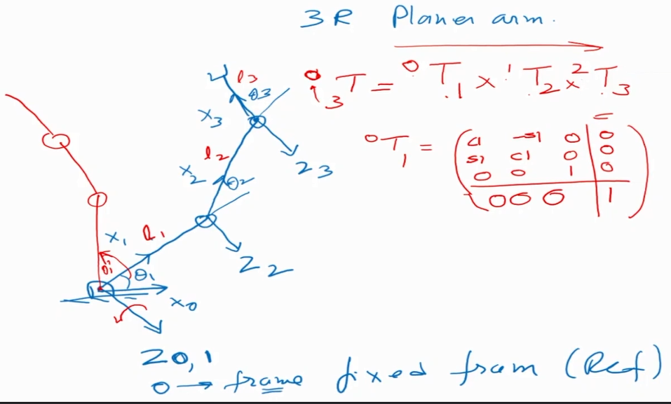
Use of homogenous matrix – to find the position and orientation of the end effector with respect to the Base frame This example shows how transformation matrix works

Slide 2
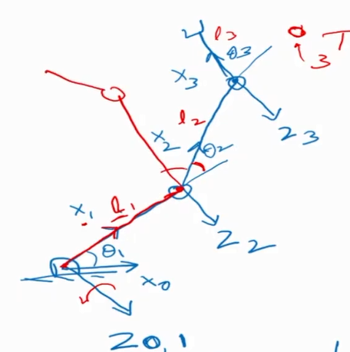
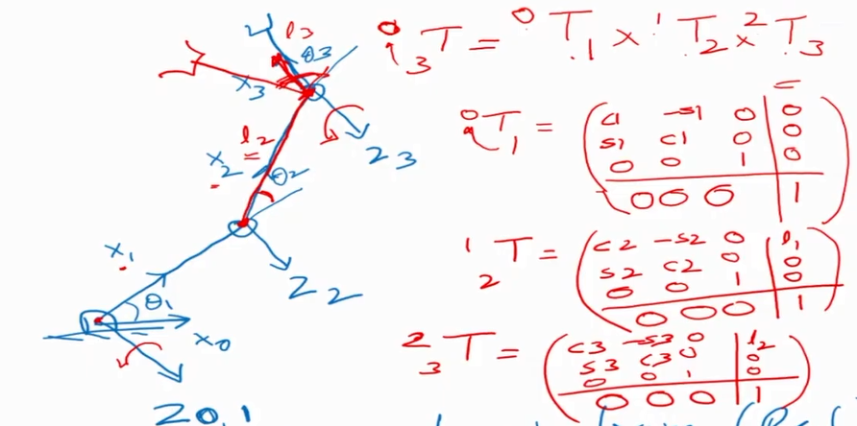

Slide 3
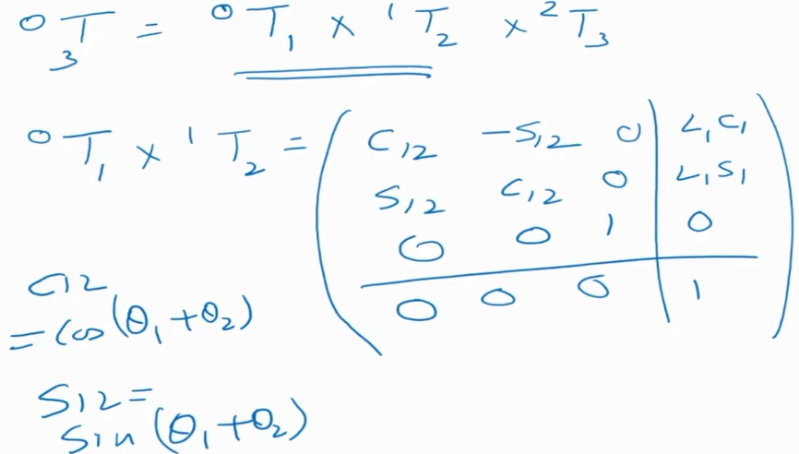

Slide 4
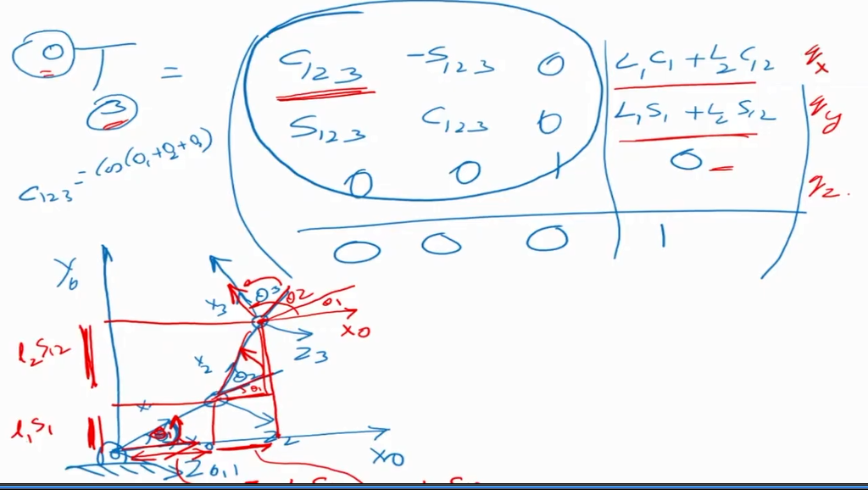

Slide 5
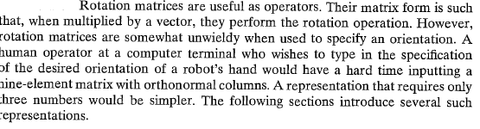
Representation of orientations

Slide 6
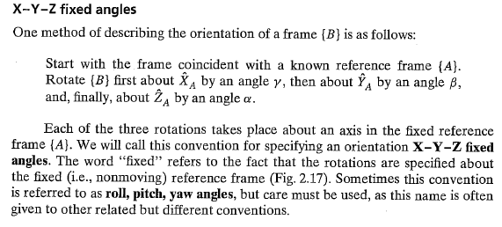
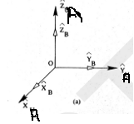
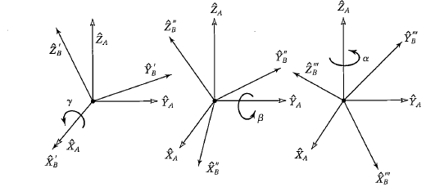
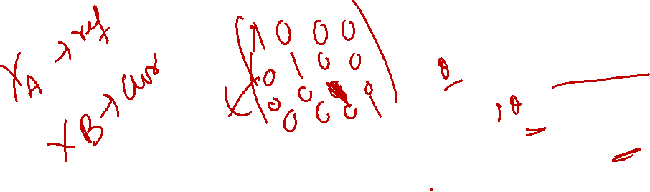

Slide 7
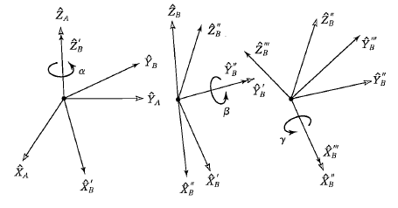
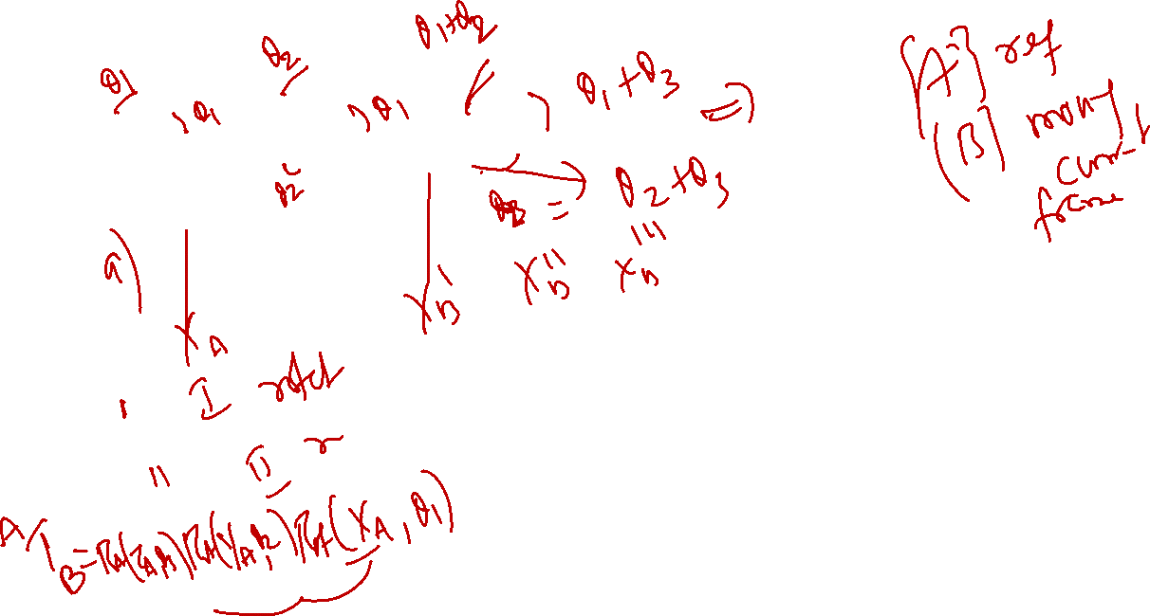

Slide 8



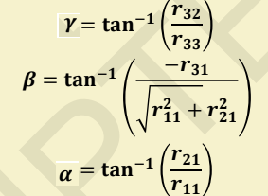
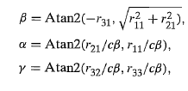
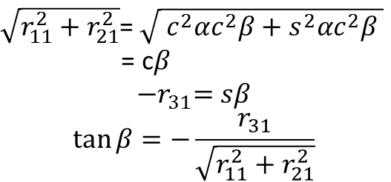
$\sqrt{r_{11}^{2}+r_{21}^{2}}$= $\sqrt{{ c}^{2}αc^{2}β+s^{2}αc^{2}β }$
= c$β$
$${−r}_{31}=sβ$$
$$\tan{β}=−\frac{r_{31}}{\sqrt{r_{11}^{2}+r_{21}^{2}}}$$

Slide 9
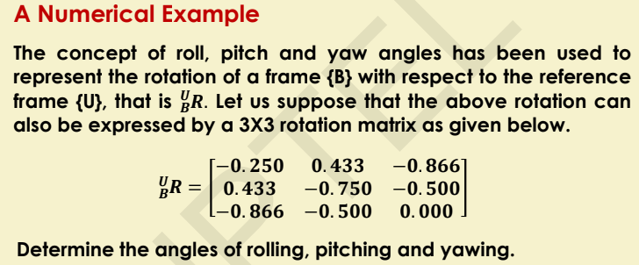
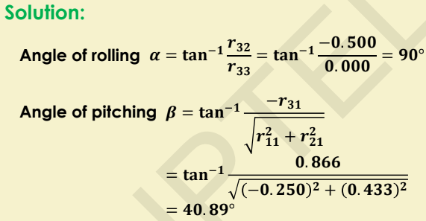
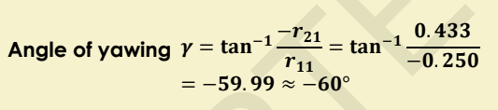

Slide 10
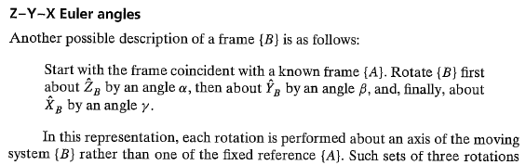

Slide 11
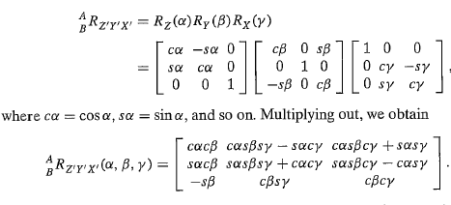
Note that the result is exactly the same as that obtained for the same 3 rotations taken in the opposite order about fixed axes. i.e. three rotations taken about fixed axes yield the same final orientation as the same three rotations taken in opposite order about the axes of the moving frame

Slide 12
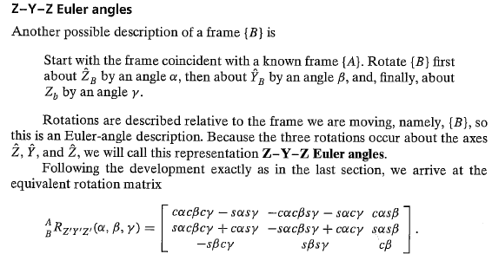

Slide 13
